Slide 1
Design Principle and Concepts

Slide 2
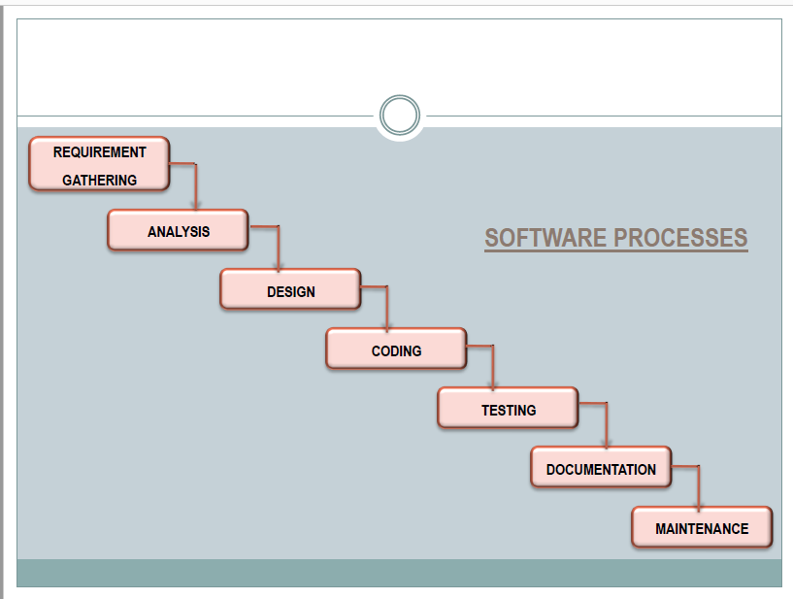

Slide 3
The data design transforms the information domain model created during analysis into the data structures that will be required to implement the software. The data objects and relationships defined in the entity relationship diagram and the detailed data content depicted in the data dictionary provide the basis for the data design activity.
Part of data design may occur in conjunction with the design of software architecture. More detailed data design occurs as each software component is designed.

Slide 4
The architectural design defines the relationship between major structural elements of the software, the “design patterns” that can be used to achieve the requirements that have been defined for the system, and the constraints that affect the way in which architectural design patterns can be applied.

Slide 5
The interface design describes how the software communicates within itself, with systems that interoperate with it, and with humans who use it. An interface implies a flow of information (e.g., data and/or control) and a specific type of behavior. Therefore, data and control flow diagrams provide much of the information required for interface design.

Slide 6
The component-level design transforms structural elements of the software architecture into a procedural description of software components. Information obtained from the PSPEC, CSPEC, and STD serve as the basis for component design.

Slide 7
But why is design so important?
The importance of software design can be stated with a single word—quality. Design is the place where quality is fostered in software engineering. Design provides us with representations of software that can be assessed for quality. Design is the only way that we can accurately translate a customer's requirements into a finished software product or system.

Slide 9
A procedural abstraction is a named sequence of instructionsthat has a specific and limited function.
An example of a procedural abstraction would be the word open for a door. Open implies a long sequence of procedural steps (e.g., walk to the door, reach out and grasp knob, turn knob and pull door, step away from moving door, etc.).

Slide 10
A data abstraction is a named collection of data that describes a data object.
In the context of the procedural abstraction open, we can define a data abstraction called door.
Like any data object, the data abstraction for door would encompass a set of attributes that describe the door (e.g., door type, swing direction, opening mechanism, weight, dimensions)

Slide 11
ccclxxi

